Slide 1
VHF102 Transverter Integration
By Bill Schwantes W7QQ
DM75ao Santa Fe

Slide 2
Why add a Transverter?
New Band with Unique Propagation
More Contest Points
Explore Microwave Bands
Better Receive Sensitivity
Better strong signal handling
Better filtering and close frequency interference
It’s fun!

Slide 3
Transverter Selection
What do you want to accomplish?
Contesting
Digital modes
Moonbounce
Satellite Ops

Slide 4
Transverter Selection
Features --
Output Power
Operating voltage
Frequency precision and stability
Drive power compatibility
IF frequency compatibility
Split IF
Split RF
Factory support
Integration with an existing HF radio
Price

Slide 5
Terms
Transverter -- In radio engineering, a transverter is a radio frequency device that consists of an upconverter and a downconverter in one unit. Transverters are used in conjunction with transceivers to change the range of frequencies over which the transceiver can communicate.
IF Radio -- Usually an HF transceiver
Split IF -- Separate receive and transmit IF signal paths
Split RF -- Separate receive and transmit RF signal paths
LO -- Local Oscillator

Slide 6
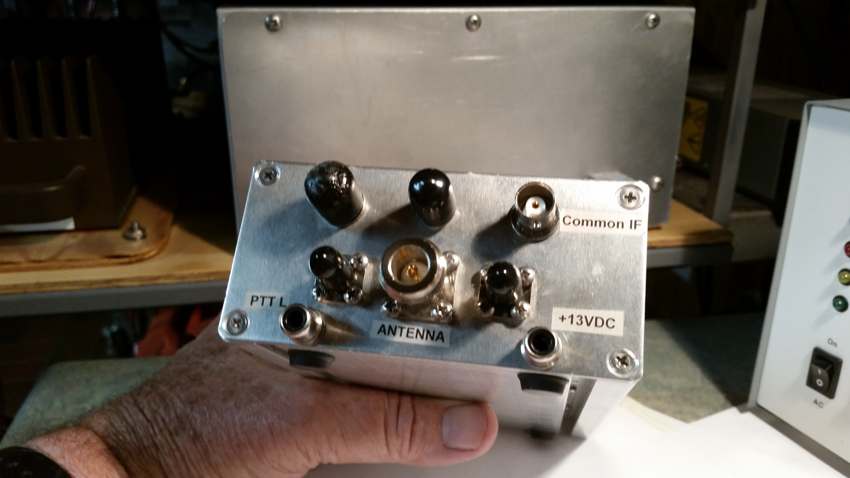
Interface Configurations
Common IF
Common RF

Slide 7
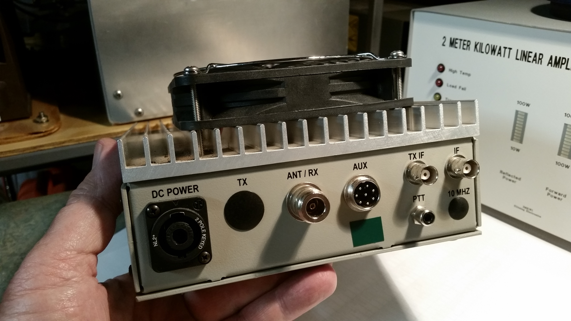
Interface Configurations
Split IF -- Separate
receive and transmit
(IF and TX IF)
Common RF (Ant/Rx)

Slide 8
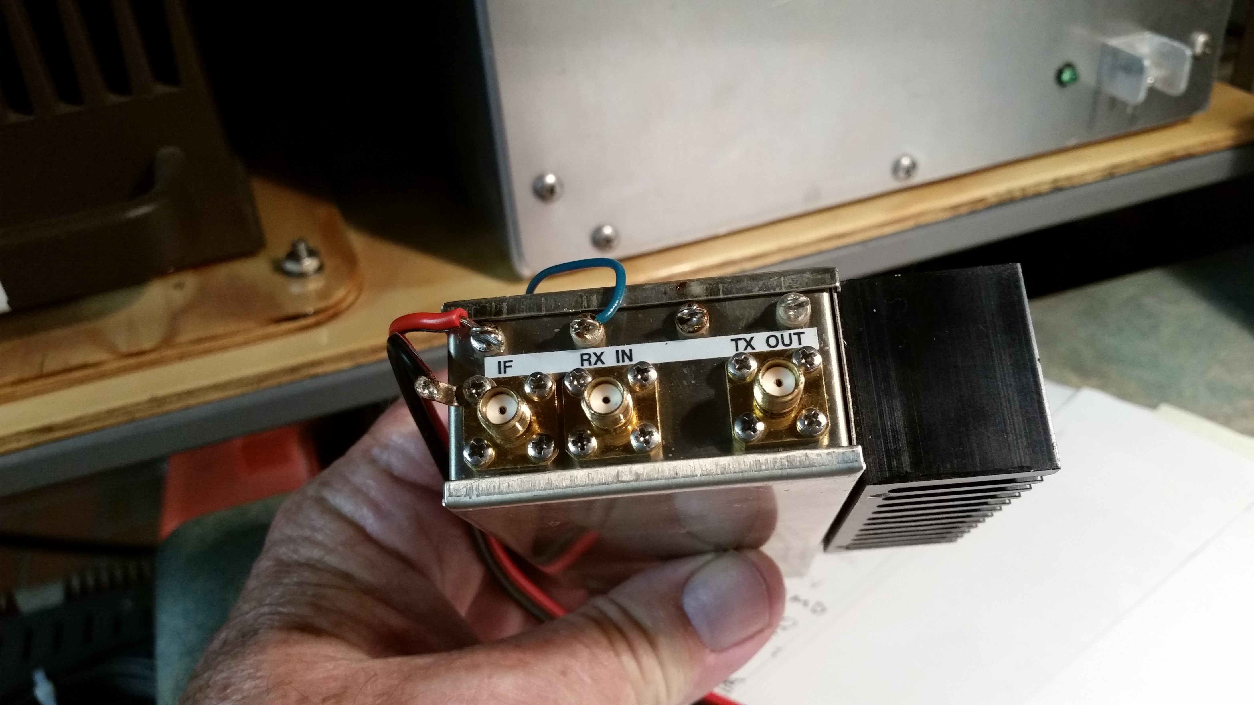
Interface Configurations
Common IF -- Rcv and Tx
Signals go both directions
(Internally switched)
Split RF -- Rcv and Tx
signals separate

Slide 9
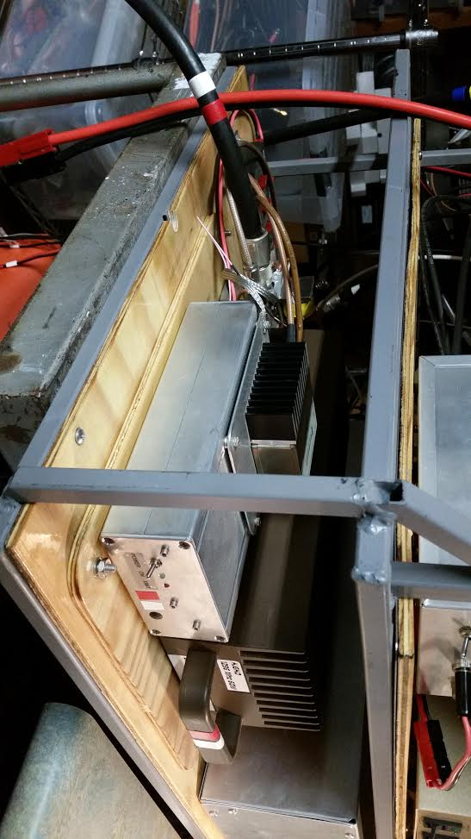
Interface Configurations
Two coupled transverters:
Lower one is 28 to 144
Upper one is 144 to 1296
External TR relay in the back

Slide 10
Transverters
Capable of operating on any mode -- CW, SSB, FM, Digital, SSTV etc.
Contains a local oscillator and mixer that creates the frequency shift
Sometimes multiplied
Example 1: 50.125 transverter input/output is created by 28.1 MHz IF + LO of 22 MHz
Example 2: 1296.1 MHz transverter input/output is created by 28.1 MHZ IF input = 28.1MHz + (LO = 105.6667 times 12x multiplier)….. 1296.1
Some transverters operate on IF of 144 or 432 MHz.

Slide 11
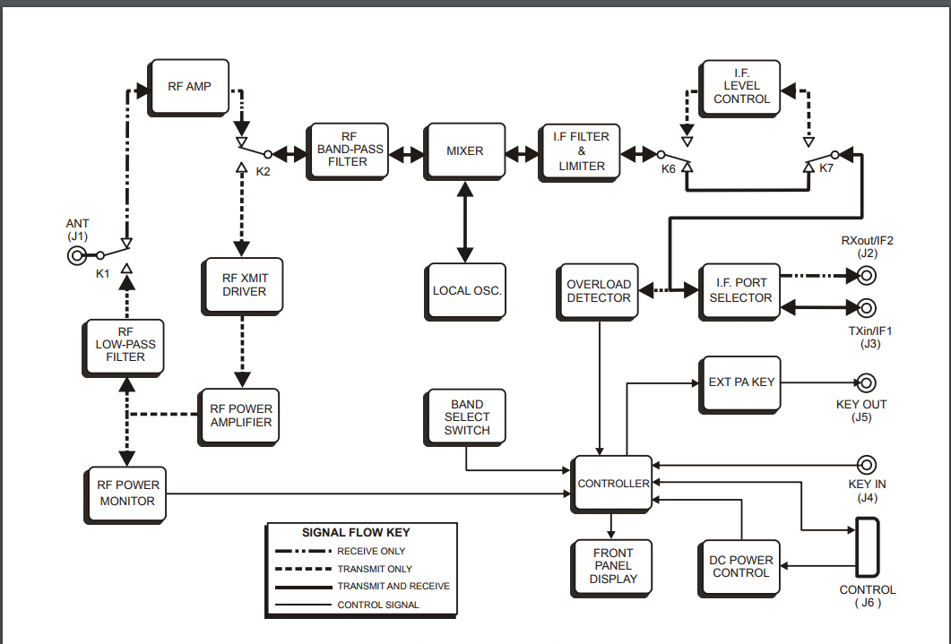
Transverters

Slide 12
Transverter Frequency Offset
Errors in Local Oscillator frequency can become multiplied and become significant.
Frequency drift can cause frequency to move usually during transmission.
Precision and stability improve on more expensive transverters.
Some IF radios feature a programmable offset where the selected frequency displays on the IF radio’s VFO display.
Without that IF feature one may “take notes” on
offset and drift characteristics as an operating
Reference
Transverter offset placards are useful as well

Slide 13
Sequencing
By now you’ve found that switching the various signal paths can be complicated and important.
While not an introductory subject, sequencing is a method which keeps amplified transmit signals out of sensitive receive pre-amplifiers and avoids switching signal levels which may damage or degrade switching components.
It’s best to understand sequencing theory before adding power amplifiers, mast mounted pre-amps or using a high level IF drive.
Some transverters include an internal sequencer.

Slide 14
Transverter Sources
Elecraft -- available in 50, 144, 222 and 432 Mhz -- integrates beautifully with K2 or K3 -- Made in USA, good support
Kuhne Electronics (DB6NT) -- Compact, high performance, 70 MHz through 78 GHz
Downeast Microwave (DEMI) -- Rugged, High performance, max flexibility, vast array of options and solutions -- Made in USA, good support
Transverters Store -- Ukrainian, sets the standard for value…. $75!
Ten Tec -- No longer made but good value if available
Others as well, kits recommended.
Many pre-owned transverters may be reconfigured to fit your needs with little effort.

Slide 15
IF Radio Sources
Elecraft K2 with K60XV, KIO2 and KSB2. No 6 meter band or FM mode
Elecraft KX3 -- 6 meters and FM included,
Elecraft K3 with KIO3b, K144xv, KXV3b or K3s with K144XV -- it has it all. 6 meters included.
Yaesu FT-817nd -- can interface on 28, 144 and 432 MHz, compact
Kenwood TS-2000 -- has transverter drive levels and good integration. Can set power by band…. Handy.
Flex 1500 -- Software defined. Good visual slice of the band. 5 watts.
Other HF radios are good too -- read up on key down power spikes and drive level controls. Any 28 MHz radio can be made to work; even the single band Radio Shack HTX-10

Slide 16
Basic Interfaces
IF Transmit and receive (TX drive power and receive signal path)
RF Transmit and Receive (To antenna)
DC supply (Usually 12 vdc) -- use a fused source
Transmit/receive controls (PTT)
You’ll need to manage these in order to successfully integrate a transverter into your system

Slide 17
IF Drive
IF radios with low level transverter drive preferred
Reducing IF drive can be tricky
Key down ALC power spikes (IF radio)
Attenuators
Delays and sequencers
DEMI TIB
Most transverters have a wide range (20 dB) of IF drive accommodation
Most transverters have enough IF gain to accommodate external attenuation (to adjust Tx drive) without compromising receive performance.

Slide 18
Your New Transverter
Don’t forget to turn it on and listen!

Slide 19
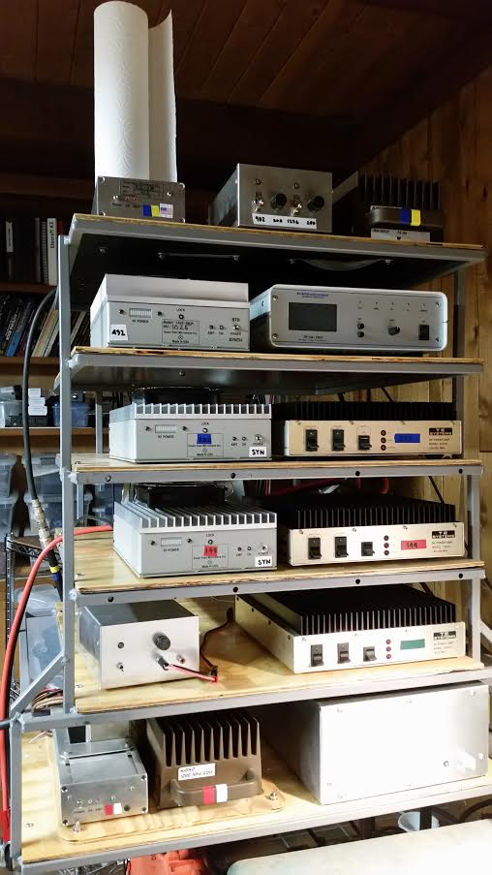
You can’t have too many!
144 through 1296

